Slide 1
CRYPTOGRAPHY
Lecture 4
Instructor:
dr. zainab abaid

Slide 2
Part 2
Symmetric key cryptography

Slide 3
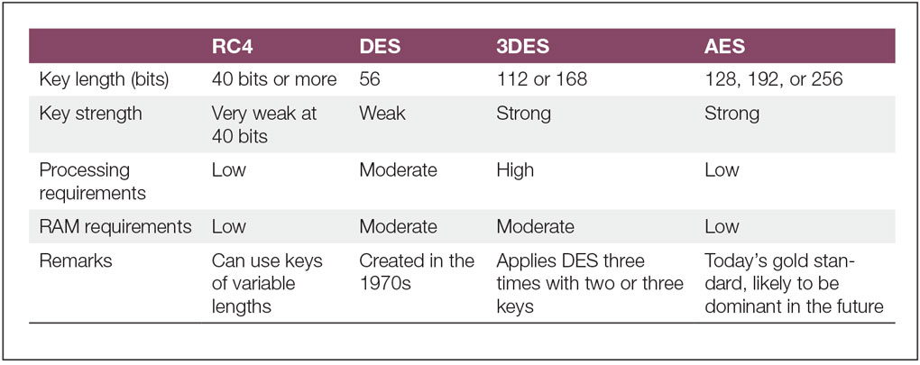
Symmetric Key Encryption Ciphers
The most common well-tested ciphers include RC4, DES, 3DES, and AES
Notes:
The weakest cipher in common use today is RC4, which is usually pronounced as “ARK FOUR.” RC4 has two advantages over other popular encryption algorithms.
In 1977, the U.S. National Bureau of Standards, which is now the National Institute of Standards and Technology (NIST), created the Data Encryption Standard (DES). DES quickly became the most widely used symmetric key encryption method.
Where firms need stronger encryption than DES provides, they can turn to triple DES (3DES), which extends the effective key size of DES in a simple but painfully slow way that uses a moderate amount of RAM.
In response to the weak key length of DES and the processing burden of 3DES, NIST released the Advanced Encryption Standard (AES) in 2001. AES is efficient enough in terms of processing power and RAM requirements to be used on a wide variety of devices—even cellular telephones and personal digital assistants (PDAs).

Slide 4
Need for New Standard? AES is born
DES had been used for a long time
Replacement was needed
Theoretical attacks that could break it
Demonstration of exhaustive key search attacks
Could use Triple DES but too slow
US NIST issued call for ciphers in 1997
15 candidates accepted in June 1998
5 were shortlisted in 1999
Rinjadel was selected as the AES in October 2000
In the Rijndael Proposal, the block length and the key length can be 128, 192, 256
AES standard limits it to128 bits, but key length can be varied
Easy to implement both in hardware and software
Resistant against all known attacks.
4
Notes:
4

Slide 5
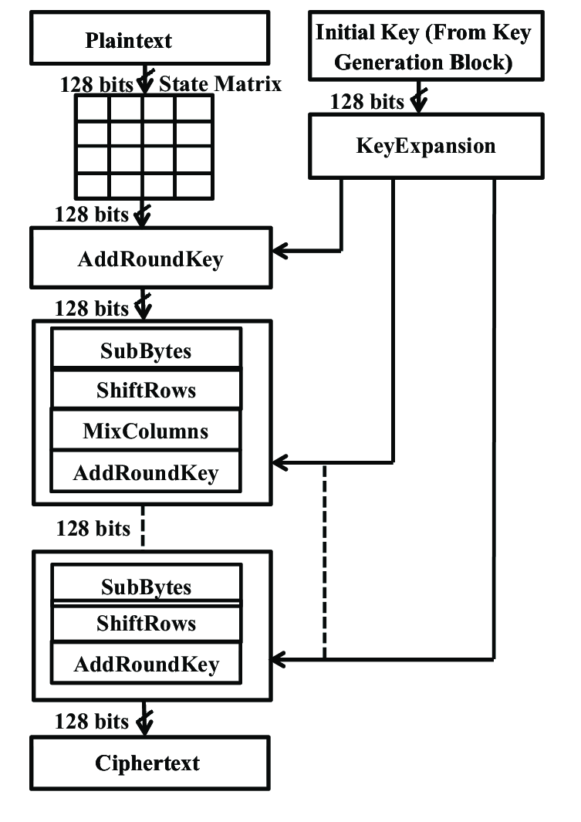
AES: The big picture
Notes:
The encryption is done in blocks (of 128 bits). Divide the text into 128 bit chunks, pad end as needed.
Apply the entire algorithm to each 128 bit chunk one by one.
Each 128 bit chunk encrypted as follows.
We run a number of “rounds” to encrypt each chunk. 10 rounds for 128-bit AES.
Per round:
Input: One state array (initially, the 128 bit chunk represented as a hexadecimal, 4x4 matrix). Output: another state array, which is the jumbled up input matrix.
Processing on the input in each round: Sub-bytes, shift rows, mix columns and add round key.
Exceptions: in the first round we first add the original key, K0, before starting sub-bytes, and in the last round we skip mix-columns.
Final output of last round is the ciphertext.

Slide 6
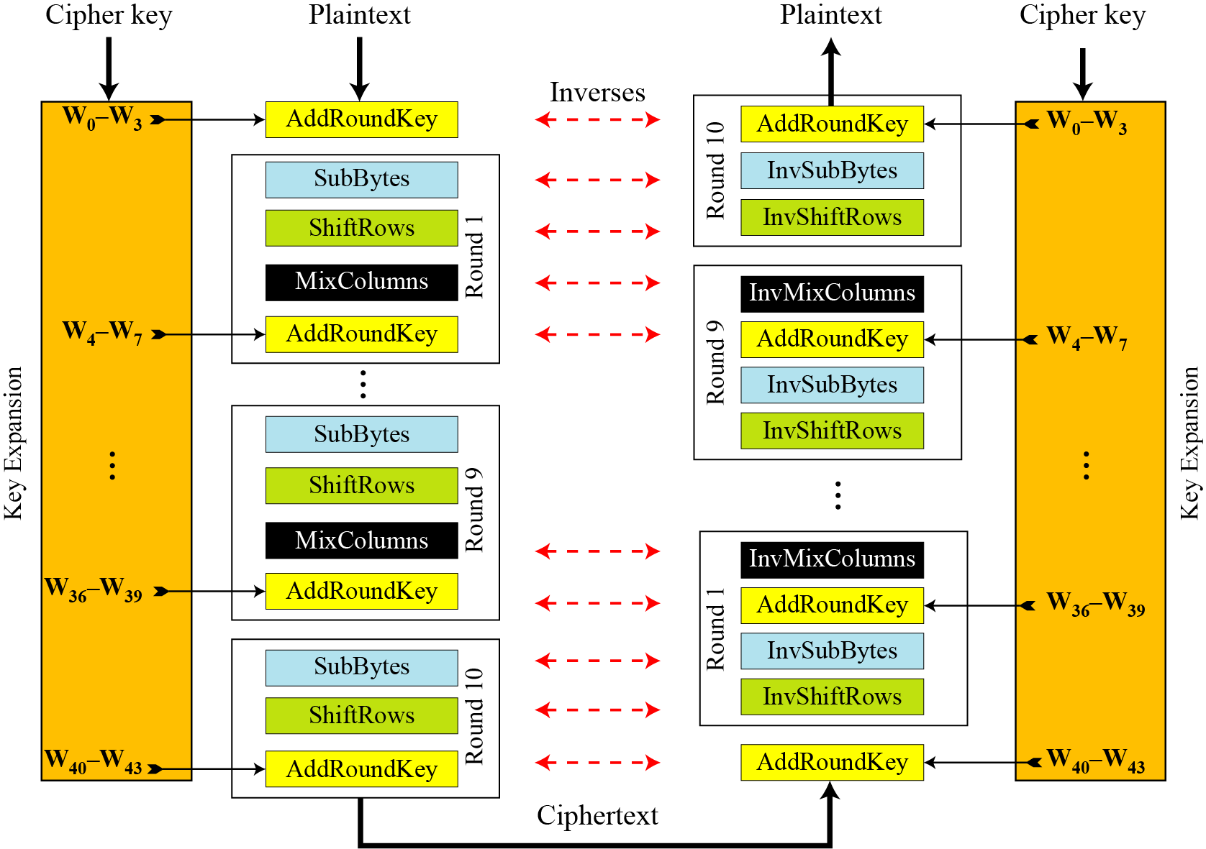
Overall Structure
Notes:
Stallings Figure 5.1 shows the overall structure of AES, as detailed on the previous slide.

Slide 7
128-bit values
Data block viewed as 4-by-4 table of bytes
Represented as 4 by 4 matrix of 8-bit bytes.
Key is expanded to array of 32 bits words
1 byte

Slide 8
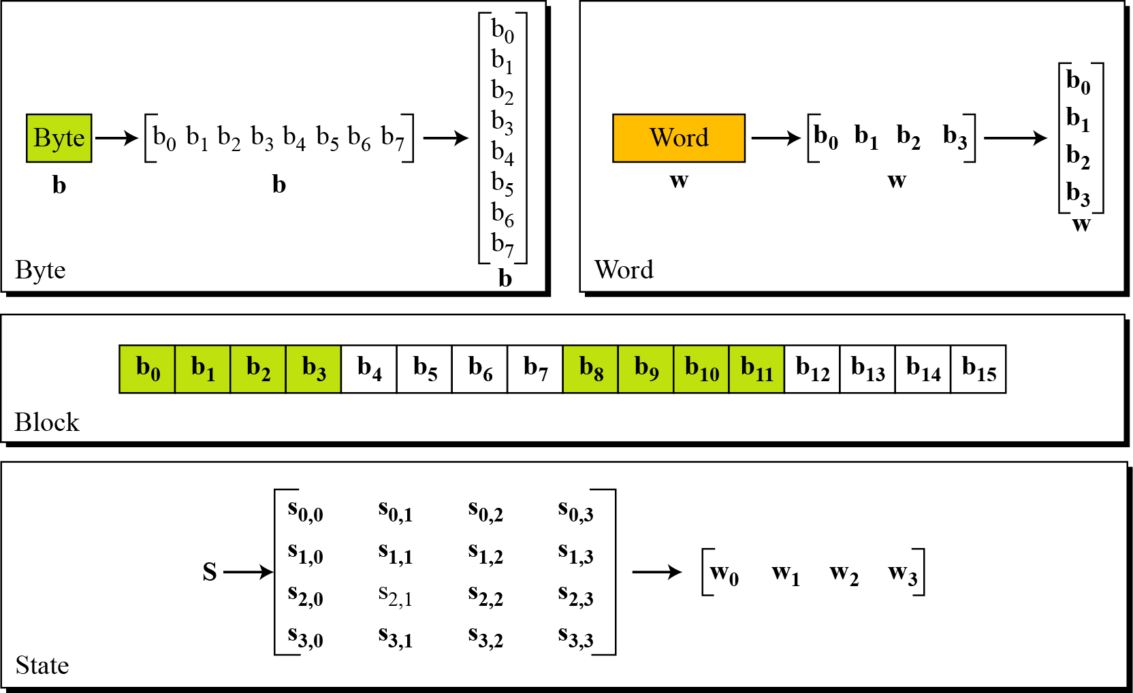
Data Unit

Slide 9
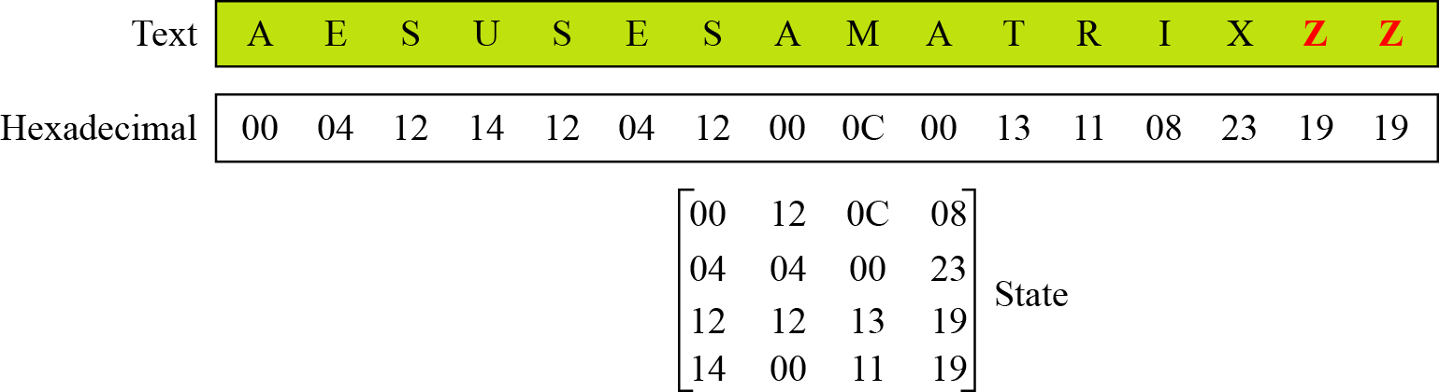
Changing Plaintext to State

Slide 10
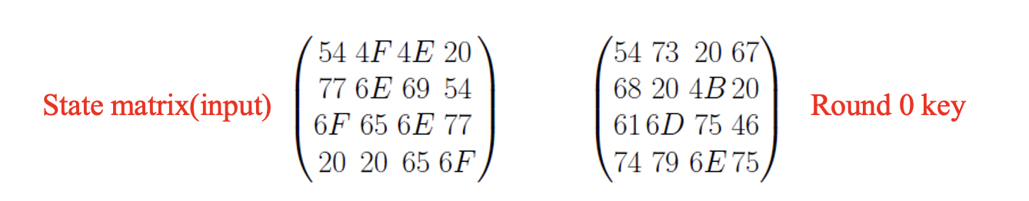
Everything starts with the plaintext (And a key)
Plaintext: Two One Nine Two
Key: Thats My Kung Fu
Step 1: Convert both to Hex
Key: 54 68 61 74 73 20 6D 79 20 4B 75 6E 67 20 46 75
Plaintext: 54 77 6F 20 4F 6E 65 20 4E 69 6E 65 20 54 77 6F
Step 2: Represent both as a STATE MATRIX.

Slide 11
Key expansion
The user will only input one key, but AES needs a different key for each round
For a total of n+1 keys, where n is the number of rounds
Thus the original key needs to be expanded
E.g. for 10-round AES, 10 additional keys have to be generated based on the input key (which we call the key for round zero, K₀)
This is done using some byte substitution, word rotation and XOR operations.
We will look at these at the end of the lecture
The point is that at the end of the key expansion phase, a 4-word key is essentially expanded to a 44-word key (for 10-round AES).

Slide 12
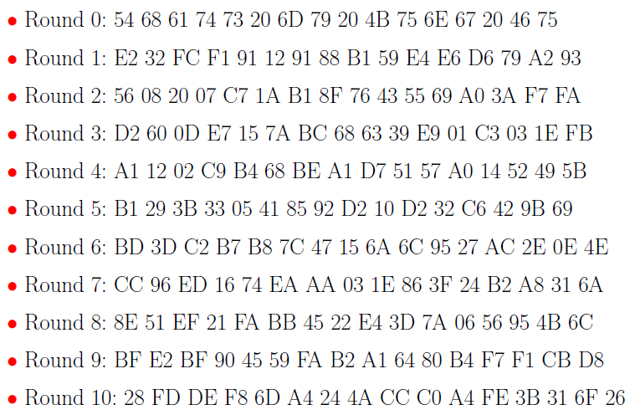
Key expansion
For this example we will get
12
Notes:
12

Slide 13
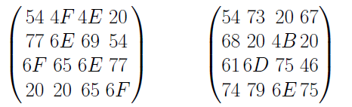

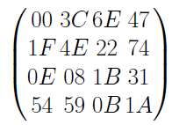
AES : Round 0: Add Round Key
Now as we are done with key expansion, we can move on with round zero, which is only Add Round Key (Before regular rounds: see algorithm)
In this round we simply Add (XOR) the state matrix(input) with the round key which in this case is key 0.
Xoring the corresponding entries we will get:
13
Notes:
13

Slide 14
Regular Rounds
Next come the ten rounds
The steps in Regular rounds are
SubBytes
ShiftRows
MixColumns
AddRoundKey
14
Notes:
14

Slide 15
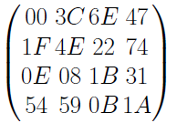
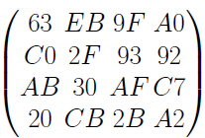
Sub-Bytes
Current State Matrix is
Substitute each entry (byte) of current state matrix by corresponding entry in AES S-Box (Already given)
For instance: byte 6E is substituted by entry of S-Box in row 6 and column E, i.e., by 9F
This leads to new State Matrix
this non-linear layer is for resistance to dierential and linear cryptanalysis attacks
15
Notes:
15

Slide 16
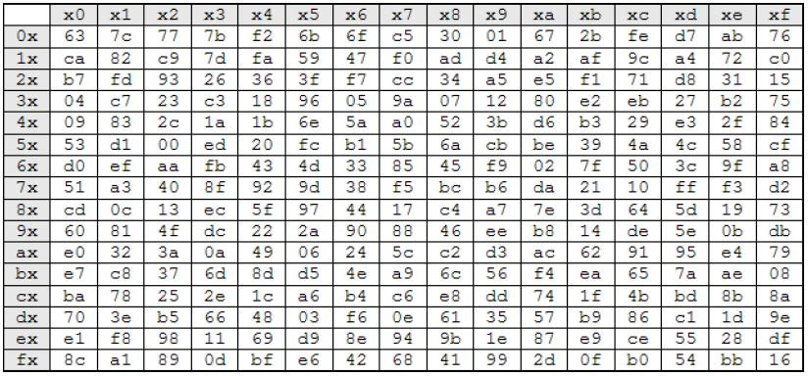
The aes s-box
Notes:
Image source: https://www.researchgate.net/publication/318906543/figure/fig4/AS:790611112251395@1565507786848/AES-S-Box-Rijndael-S-Box-16.jpg

Slide 17
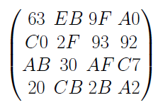
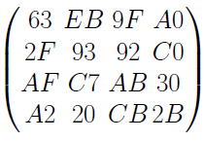
Shift-Rows
The current State Matrix is
Four rows are shifted cyclically to the left by offsets of 0,1,2, and 3
The new State Matrix is
This linear mixing step causes diffusion of the bits over multiple rounds
17
Notes:
17

Slide 18
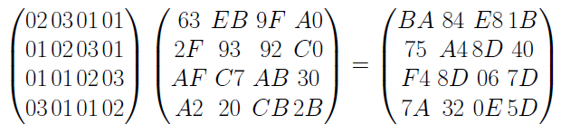
Mix-Columns
Mix Column multiplies a fixed matrix (from the original Rijndael design) against current State Matrix:
Entry BA is result of (02 * 63) (03 * 2F) (01 *AF) (01 * A2)
18
Notes:
18

Slide 19
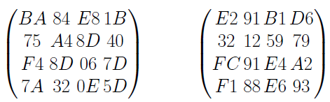
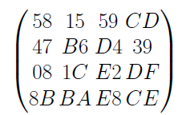
Add-Round-key
State Matrix and Roundkey No.1 Matrix:
XOR yields new State Matrix
AES output after Round 1: 58 47 08 8B 15 B6 1C BA 59 D4 E2 E8 CD 39 DF CE
19
Notes:
19

Slide 20
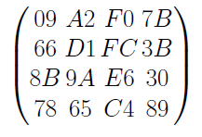
Regular Rounds: 9 for 128 bit
For Round 8 we will get
So the final state matrix after regular rounds will be
20
Notes:
20

Slide 21
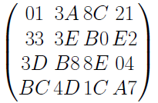
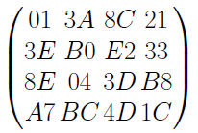
Last Round
The steps in the last round are
SubBytes
ShiftRows
AddRoundKey
Input is the state matrix after round 9
After SubBytes we get
ShiftRows results in
21
Notes:
21

Slide 22
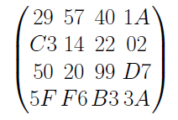
Last Round
After Add Round key we get
Which is our ciphertext: Read as
29 C3 50 5F 57 14 20 F6 40 22 99 B3 1A 02 D7 3A
22
Notes:
22

Slide 23

Back to key expansion
Now that you understand the substitution and rotation procedures, let’s have a look at how the key is actually expanded.

Slide 24
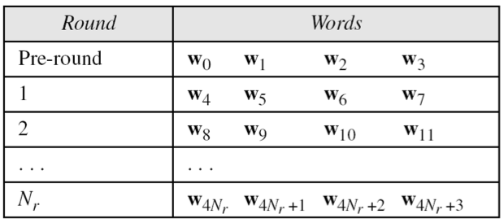
AES Key Scheduling
Takes 128-bits (16-bytes) key and expands into array of 44 32-bit words
Notes:
The AES key expansion algorithm takes as input a 4-word (16-byte) key and produces a linear array of words, providing a 4-word round key for the initial AddRoundKey stage and each of the 10/12/14 rounds of the cipher. It involves copying the key into the first group of 4 words, and then constructing subsequent groups of 4 based on the values of the previous & 4th back words. The first word in each group of 4 gets “special treatment” with rotate + S-box + XOR constant on the previous word before XOR’ing the one from 4 back. In the 256-bit key/14 round version, there’s also an extra step on the middle word.

Slide 25
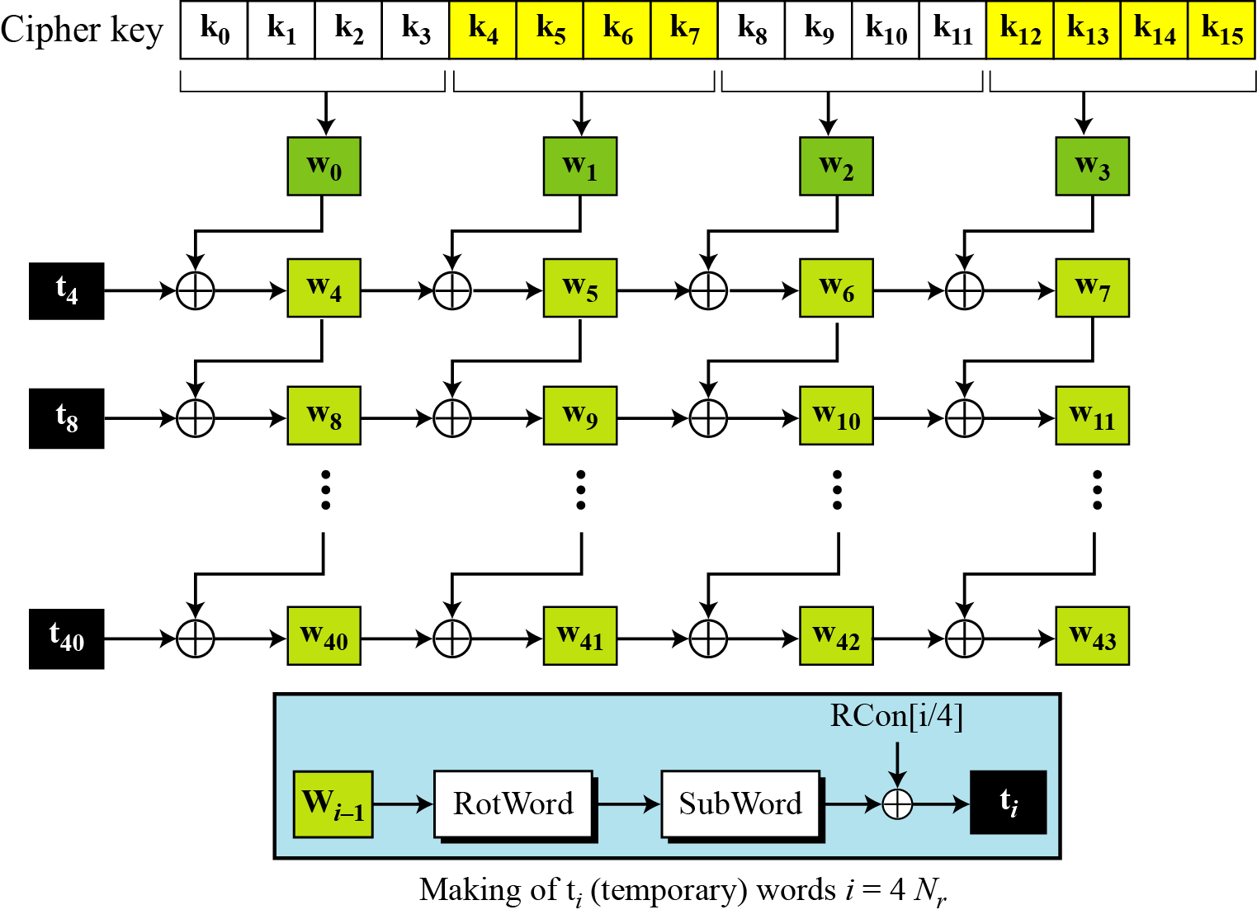
Key Expansion Scheme
Notes:
Nr = number of rounds.

Slide 26
Key Expansion submodule
RotWord performs a one byte circular left shift on a word For example:
RotWord[b0,b1,b2,b3] = [b1,b2,b3,b0]
SubWord performs a byte substitution on each byte of input word using the S-box
SubWord(RotWord(temp)) is XORed with RCon[j] – the round constant

Slide 27
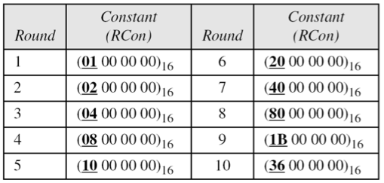
Round Constant (RCon)
RCON is a word in which the three rightmost bytes are zero
It is different for each round and defined as:
RCon[j] = (RCon[j],0,0,0)
where RCon[1] =1 , RCon[j] = 2 * RCon[j-1]

Slide 28
Final thoughts
Why is the S-box, Rcon, and MixCols constant matrix fixed?
Should they not be randomized for better (harder to break) encryption?

Slide 29
Sources
Some of the slide material is borrowed from:
https://cpe.ku.ac.th/~nguan/class/204427-54/slides/01204427-AES.ppt
https://www.kavaliro.com/wp-content/uploads/2014/03/AES.pdf

